Slide 1
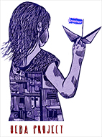
Karel Moons and Melanie van Oort-Hall
HEDA-methodology (10-step Teaching Method) to learn about democratic principles and values
HEDA - KA220-SCH - Cooperation Partnerships in School Education
Dissemination Workshop – 26 February 2024

Slide 2
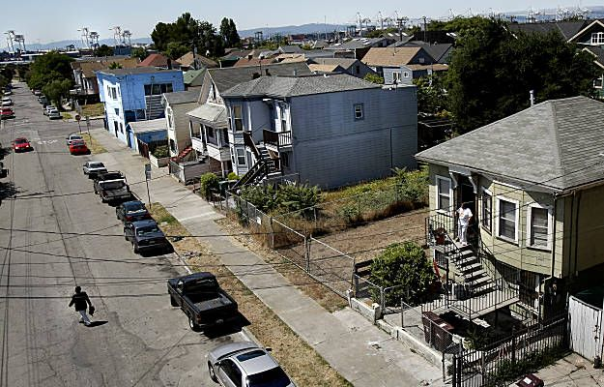
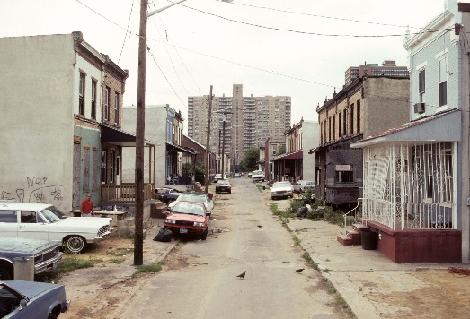
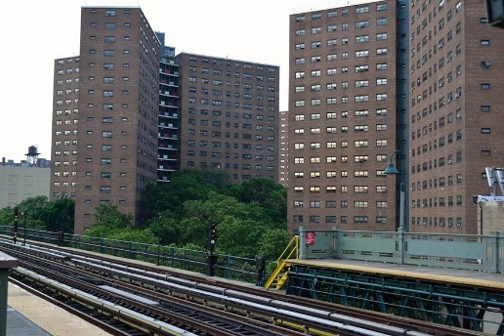
Does your city/country have areas where there is a lot of poverty and crime? Why?

Slide 3
If your city/country has areas where there is a lot of poverty and crime, is there as much crime in wealthy areas? Why or Why not?

Slide 4
Gangsta ‘Paradise’?

Slide 5
Some questions to think about before we begin: Discuss in pairs …
What is the Hood? Is it a good place to live? Why or Why not?
What happens to schools in the Hood? Are teachers motivated? Why or why not?
How do people protect themselves? Make money? ‘Advance’ in their communities?
The protagonist in the Video we just saw, compares formal education to education on the streets. What do you ‘learn’ on the streets?
What could be the meaning of the ‘wise foolish man’ or the ‘foolish wise man’?

Slide 6
HEDA-Project. Erasmus + Cooperation Partnerships in School Education
HEDA stands for Human-Europe-Democracy-Art. It is a method to teach about social and civic issues in secondary education (12 to 18 years-old). Through theatre (plays) and other forms of art (poetry, songs, speeches, articles, paintings, sculpture…)
The HEDA-project wants to cultivate the abilities and sensitivities of young people about the importance of democratic values and human rights for European society.
To make them aware of their social, political and human rights but also responsibilities as citizens of an organized, democratic society
based on humanitarian values and the rule of law.

Slide 7
HEDA-methodology (10-step Teaching Method) to learn about democratic principles and values
The HEDA-methodology takes the teacher through 10 straight-forward steps that they can use to teach issues relating to democracy, human rights and citizenship through theatre and art.
In this workshop, we divide the methodology into 3 Parts.
1. Background Preparation (historical, economic, ethnical) for the topic to be discussed (Steps 1 – 4)
2. Theatre Exercises relevant to the topic (Steps 5 – 8)
3. Discussion and Debate (Steps 9 and 10)
Given time constraints, we will only address Parts 1 and 2.

Slide 8
HEDA-methodology (10-step Teaching Method) to learn about democratic principles and values Strengths-based learning?
The HEDA-methodology takes the teacher through 10 straight-forward steps that they can use to teach issues relating to democracy, human rights and citizenship through theatre and art.
Search for information
Choosing a piece of art
Adapting the piece of art
Highlighting the points of discussion
Introduction of the lesson and discussion about the central concepts
Introduction of the piece of art
First reading of the text
Working in an active way with the piece of art
Students discuss the points of discussion (step 4) based on their experiences in step 8
Students (prepare) and execute a debate based on the content of the lesson
Preparation or as much as possible done by students?
Lesson
students

Slide 9
Overview of our workshop: HEDA-methodology and Strength-Based Learning.
Topic: Adequate Housing and safe neighbourhoods as a basis for Democracy and Human Rights.
Piece of art: Gangsta Paradise (Coolio)
Part 1: SBL-lesson about Adequate Housing
Part 2: Theatre lesson based on Gangsta Paradise
Part 3: Short overview of the discussion (step 10)

Slide 10
Strength-Based Learning
What:
It’s both an approach and a method of teaching a curriculum, but also a system of classroom management:
How we use the strengths of students,
that they bring from their own culture and personal history in learning processes.
But it is also a way for the teacher to more actively engage students in that learning process.
Students are given both responsibility and autonomy for their own learning processes…
(Possibility to ‘choose’ and ‘adapt’ as a teacher!)

Slide 11
Strength-Based Learning
How:
Groups of 5-6 students
Choose assignments based on your own or group’s strengths
Prepare your lesson with the group, based on:
What am I doing
How will I do it.
Asking for Help and feedback
Stay together
Divide tasks and roles
Skip what you already know
If you encounter a problem, don’t ask the teacher, solve it yourself!

Slide 12
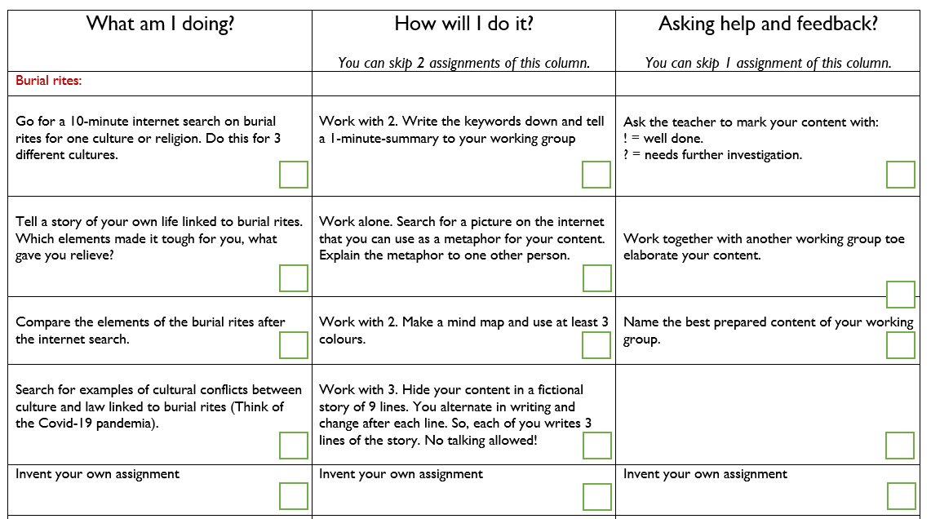
Example of SBL lesson plan
(with boxes for prioritizing activity combinations)
3
1
3
1
3
2
2
4
1
4
2

Slide 13
Part 1
Adequate Housing and Human Rights
SBL-lesson

Slide 14
We want to deal with Access to Adequate Housing as a Human Right Necessary for Democracy
Having decent or adequate housing is not just a commodity but is a basic human right.
According to the UN, “The key to ensuring adequate housing is the implementation of this human right through appropriate government policy and programmes, including national housing strategies.”
But when governments ignore housing or agree to policies that lead to de facto segregation, they undermine the economic and educational opportunities of citizens, but also their full participation in lawful civil society.

Slide 15
Some important texts you can use
See the UN’s Charter on Adequate Housing as an Element of Basic Human Rights. https://www.ohchr.org/en/special-procedures/sr-housing/human-right-adequate-housing
See also The International Covenant on Economic, Social and Cultural Rights, Articles 11.1, 12.1 and 2, 13: https://www.ohchr.org/en/instruments-mechanisms/instruments/international-covenant-economic-social-and-cultural-rights.
But also UNs Universal Declaration of Human Rights, especially articles 25.1, 26 and 27 (See link here: https://www.un.org/en/about-us/universal-declaration-of-human-rights.

Slide 16
Teams
5 Groups
Group 1
Group 5
Group 3
Group 2
Group 4

Slide 17
Action!
We already numbered some of the assignment to save time.
Start with numbering the other assignments:
Make decisions based on your strengths and energy!
Do it quick, no ‘didactical discussions’.
No debating on right or wrong …

Slide 18
Part 2
Coolio: Gangsta Paradise
Theatre-lesson

Slide 19
Methodology step-by-step (Day 2 – HEDA)
Step 6-8. ‘Acting it out’ with the students
Explain the context: source, plot, main characters and why this ‘text’ is chosen:
We are in a disadvantaged neighbourhood plagued by poverty and violence: in the homes, on the streets, in school.
The artist, Coolio, reverses the traditional gangsta rap bravado about the violent life in the Hood by providing a poetic and melancholic account of its ultimate (self)-destructiveness.
The protagonist of the song is a 23-year-old leader of a criminal gang, who reflects on his life and the decisions he makes to survive – but his time is running out. His life is governed by the law of the streets instead of the rule of law.
He narrates his short life and positions himself as the ‘wise strong fool’ of the streets, who sees its futileness, but can’t escape it.
Men like him are excluded from the good ‘normal’ life, because they trapped in the hellscape neighbourhood of the ‘gangsta paradise’.

Slide 20
Introduction Coolio’s Gangsta Paradise
For Part 2, you will work on the ‘Gangsta Rap’ song: Gangsta Paradise by the artist Coolio, to introduce you to the topics of housing and safe neighbourhoods as the basis for lawful democratic societies.
The song is about the life of a 23-year-old ‘gangster’ stuck in a tough and dangerous neighbourhood (the Hood), who is trying to survive as a gang leader. He is warning (maybe even threatening) the listener. He’s bragging about the ‘wisdom’ he got from his ‘education’ on the streets.
He’s been let down by most ‘normal’ social structures (also school); feels trapped in his situation (Hood) and has resigned himself to a life of violence and crime. According to him, his options are: Death or Jail.
→ Your job during the exercises will be to find ways to talk to him and help him to think of alternatives to his life and education on the streets.

Slide 21
Gangsta Paradise by Coolio Why Chosen…
The song ‘Gangsta’s Paradise’ is a contemporary Rap Song written in 1995 by the artist Coolio, or Artis L. Ivey, in the Rap subgenre of Gangsta Rap for the film Dangerous Minds.
‘Rap’ originated in the 1970s in New York City, e.g. the Bronx, by black DJs. In the 70’s, New York City was rife with violence and criminality from street gangs and the Mafia. Rap is an artistic expression of and voice for people who have experienced exclusion from so-called ‘normal’ civil society.
‘Gangsta Rap features stories about life on the street as a member of a ‘gang’. It often uses machoistic bravado to brag about criminal exploits and violence.
Coolio wanted to capture sense of doom and lack of perspective associated with a life in the ‘Hood’ and how schools in those neighbourhoods fail young people, because the ‘neighbourhood’ and ‘society’ failed them.
Coolio reverses the traditional Gangsta Rap bravado about life in the Hood by providing a poetic and melancholic account of its ultimate (self)-destructiveness.

Slide 22
Main Characters in the Song
The protagonist, the ‘wise’ gang leader.
Gang members (substitute family in the Hood; offer ‘friendship and protection’)
Mother (seems concerned but not much influence – where’s the father?)
Rival gang members (the enemies and are being warned)
Onlookers
Teachers (Seem uninterested or maybe just burned out; not willing to listen)

Slide 23
Now Action

Slide 24
Part 3
Discussion and Debate

Slide 25
Part 3: Students Organize Discussions & Debate Informal or Formal Debate Methods

Slide 26
Thank you!

